Slide 1
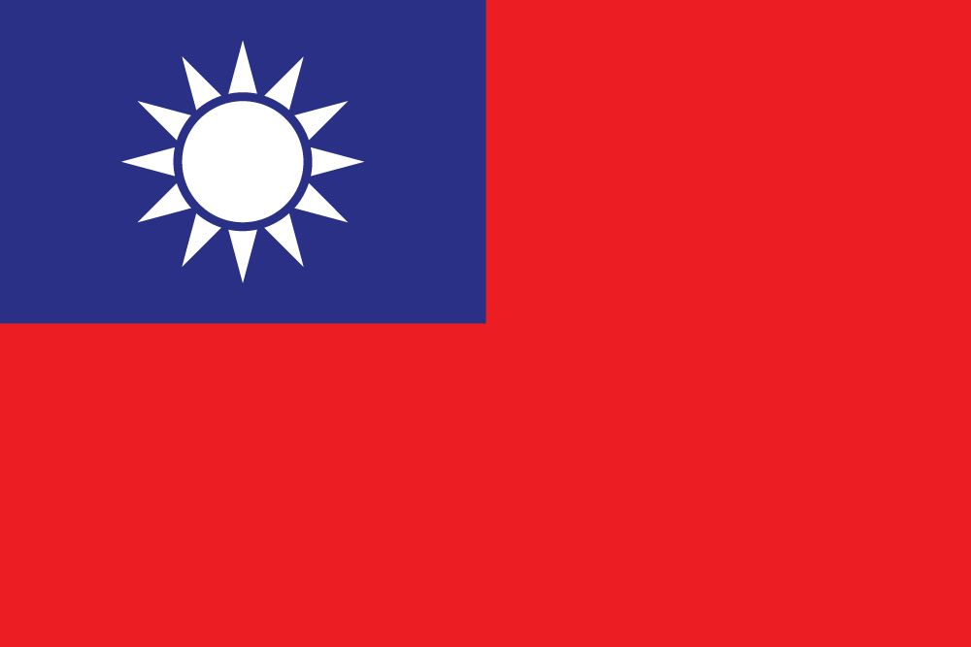
CHINA TAIWAN ISSUE

Slide 2
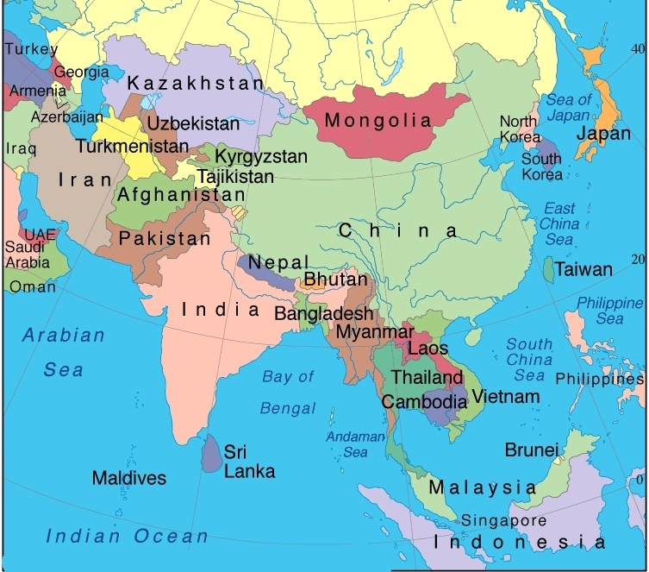

Slide 3
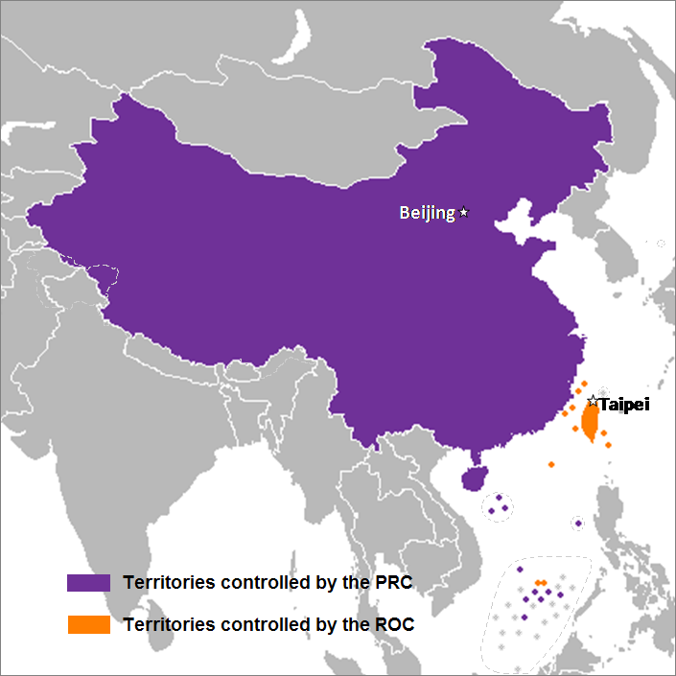

Slide 4
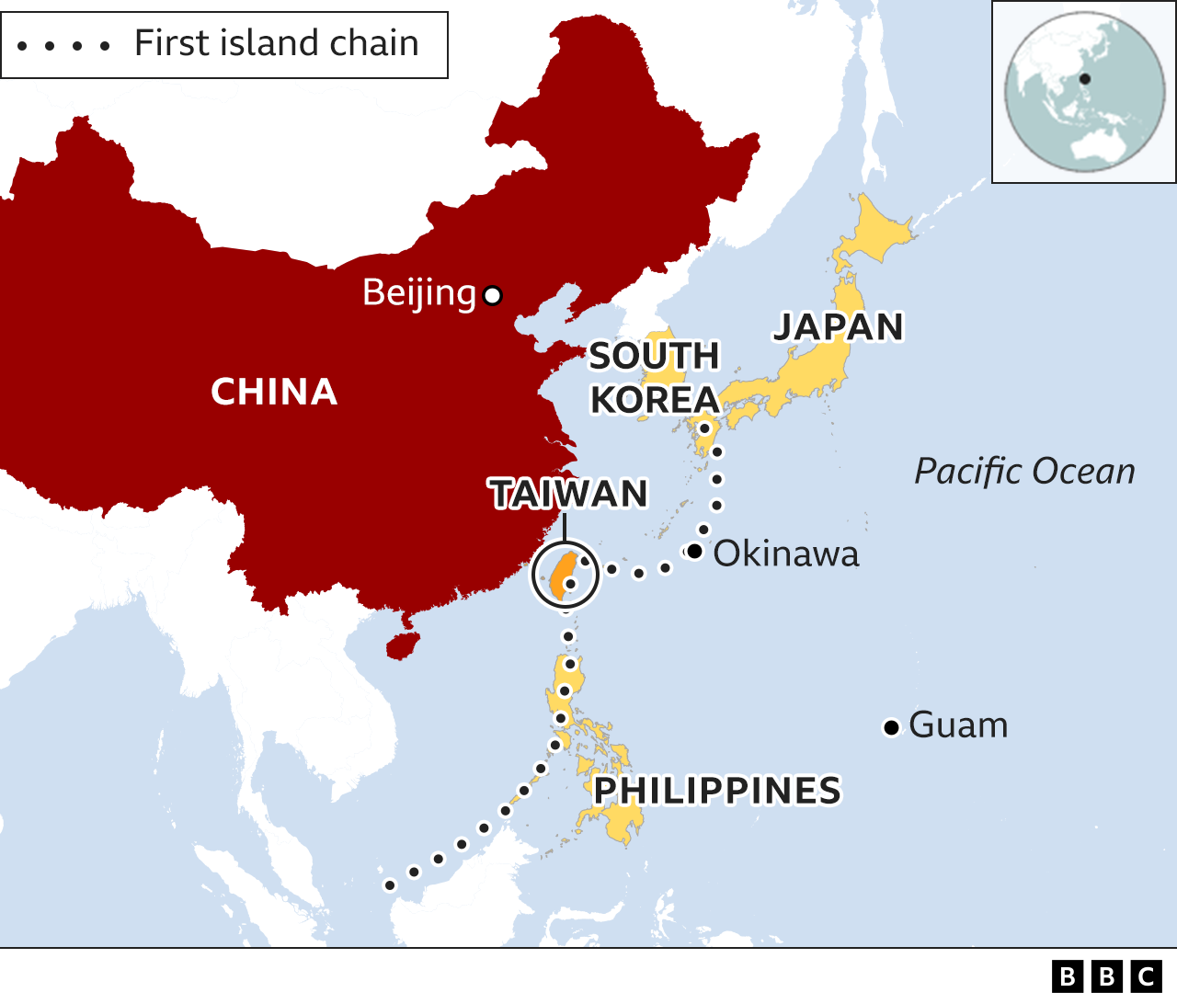

Slide 5
Geographical and Economic Importance
Geographically, the Taiwan Strait is pivotal as it connects two major seas in Asia. It’s relatively shallow with an average depth of about 490 feet, making it navigable for a multitude of vessels. Economically, it is a critical corridor for maritime trade, with millions of tons of cargo passing through annually. Major ports like Amoy in Mainland China and Kao-hsiung in Taiwan facilitate this immense trade flow. Additionally, the strait is a significant fishing ground and a potential source of energy resources like petroleum and natural gas.
The Taiwan Strait, a crucial maritime passage, holds immense global significance due to its geographical, economic, and geopolitical aspects. This 180km-wide strait, forming a link between the South China Sea and the East China Sea, is not just a key trade route but also a focal point of international politics and security concerns.

Slide 6
Taiwan: A Semiconductor Hub
Taiwan’s role as the world’s most advanced and critical semiconductor manufacturing hub cannot be understated. Its position in the strait elevates the area’s importance, as any disruption could have far-reaching implications for the global supply chain of electronics.

Slide 7
Impact of Taiwan Strait on Global Trade and Security
The Taiwan Strait’s security is closely tied to global economic stability. A potential conflict in the region, involving major powers like China and the United States, could disrupt global trade, affecting many countries economically. The strait’s strategic location makes it a focal point for power projections by regional and global powers, as evidenced by increased naval transits by countries like France, the US, Australia, Canada, Germany, Japan, and the Netherlands. These movements underscore the commitment to maintaining freedom of navigation in the face of China’s assertive actions in the region.

Slide 8
Geopolitical Significance
The Taiwan Strait is a nexus of geopolitical, economic, and military interests with far-reaching implications. Its significance extends beyond regional concerns, affecting global trade, security, and the international order. The stability of the strait is paramount, not just for the regional actors, but for the global economy and international security architecture. As geopolitical tensions continue to shape the region, the Taiwan Strait will remain a critical focus for global diplomacy and security strategies.
Taiwan, situated within a crucial node of the first island chain, anchors a network of U.S. allies crucial for regional security and defense of vital U.S. interests in the Indo-Pacific. The strait’s control impacts the balance of power in the region significantly. If China gains control over Taiwan, it could limit the U.S. military’s operations in the region, challenge the defense of U.S. allies in the Indo-Pacific, and potentially lead to a shift in the regional power dynamics.

Slide 9
Where is Taiwan?
Taiwan is an island, roughly 100 miles from the coast of south east China.
It sits in the so-called "first island chain", which includes a list of US-friendly territories that are crucial to US foreign policy.
Taiwan, officially known as the Republic of China (ROC), is an island separated from China by the Taiwan Strait. It has been governed independently of mainland China, officially the People’s Republic of China (PRC), since 1949. The PRC views the island as a renegade province and vows to eventually “unify” Taiwan with the mainland.

Slide 10
Taiwan does, however, hold member status in more than forty organizations, most of them regional, such as the Asian Development Bank and the Asia-Pacific Economic Cooperation forum, as well as in the World Trade Organization. It holds observer or other status on several other bodies.
Only fifteen states maintain official diplomatic ties with Taiwan, mostly small countries in the Pacific, Caribbean, Latin America and Southern Africa. No government has ever simultaneously maintained formal diplomatic ties with both China and Taiwan.

Slide 11
History between China and Taiwan
The first known settlers in Taiwan were Austronesian tribal people, who are thought to have come from modern day southern China.
The island seems to have first appeared in Chinese records in AD239, when an emperor sent an expeditionary force to explore the area - a fact Beijing uses to back its territorial claim.
After a relatively brief spell as a Dutch colony (1624-1661), Taiwan was administered by China's Qing dynasty from 1683 to 1895.

Slide 12
In 1895, Japan won the First Sino-Japanese War, and the Qing government had to cede Taiwan to Japan. After World War Two, Japan surrendered and relinquished control of territory it had taken from China. The Republic of China (ROC) - one of the victors in the war - began ruling Taiwan with the consent of its allies, the US and UK.
But in the next few years a civil war broke out in China, and the then-leader Chiang Kai-shek's troops were defeated by Mao Zedong's Communist army.
Chiang, the remnants of his Kuomintang (KMT) government and their supporters - about 1.5m people - fled to Taiwan in 1949.

Slide 13
His group, referred to as Mainland Chinese, dominated Taiwan's politics for many years though they only account for 14% of the population. Chiang established a government in exile in Taiwan which he led for the next 25 years.
Chiang's son, Chiang Ching-kuo, allowed more democratization after coming to power. He faced resistance from local people resentful of authoritarian rule and was under pressure from a growing democracy movement.
President Lee Teng-hui, known as Taiwan's "father of democracy", led constitutional changes towards, which eventually made way for the election of the island's first non-KMT president, Chen Shui-bian, in 2000.

Slide 14
Who recognizes Taiwan?
There is disagreement and confusion about what Taiwan is.
It has its own constitution, democratically-elected leaders, and about 300,000 active troops in its armed forces.
Despite having all the characteristic of an independent state and a political system that is distinct from China, Taiwan's legal status remains unclear.

Slide 15
Why is Taiwan important for the rest of the world?
Taiwan's economy is hugely important.
Much of the world's everyday electronic equipment - from phones to laptops, watches and games consoles - is powered by computer chips made in Taiwan.
By one measure, a single Taiwanese company - the Taiwan Semiconductor Manufacturing Company or TSMC - has over half of the world's market.

Slide 16
How are relations between Taiwan and China?
Relations started improving in the 1980s as Taiwan relaxed rules on visits to and investment in China. In 1991, it proclaimed that the war with the People's Republic of China was over.
China proposed the so-called "one country, two systems" option, which it said would allow Taiwan significant autonomy if it agreed to come under Beijing's control. This system underpinned Hong Kong's return to China in 1997 and the manner in which it was governed until recently, when Beijing has sought to increase its influence.
Taiwan rejected the offer and Beijing's insisted that Taiwan's ROC government is illegitimate - but unofficial representatives from China and Taiwan still held limited talks.

Slide 17
Then in 2000, Taiwan elected Chen Shui-Bian as president, much to Beijing's alarm. Mr. Chen and his party, the Democratic Progressive Party (DPP), had openly backed "independence".
Mr. Chen was succeeded by the KMT's Ma Ying-Jeou in 2008 who tried improving relations through economic agreements.
Eight years later, in 2016, Taiwan's current president Tsai Ing-wen, who now leads the independence-leaning DPP, was elected.
Ms Tsai won a second term in 2020 with a record-breaking 8.2 million votes

Slide 18
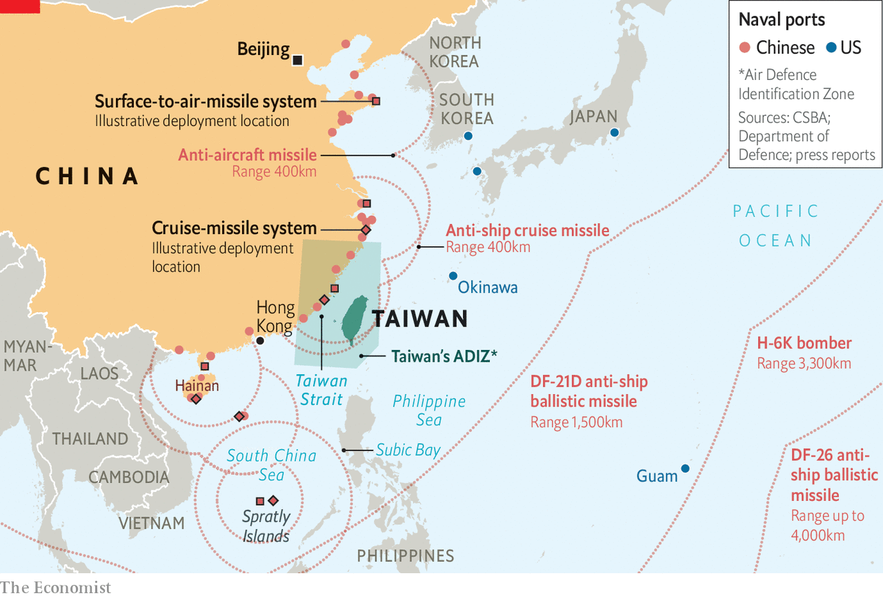

Slide 19
THUCYDIDES TRAP
Thucydides' Trap, is a term popularized by American political scientist Graham T. Allison to describe an apparent tendency towards war when an emerging power threatens to displace an existing great power as a regional or international hegemon.
It was coined and is primarily used to describe a potential conflict between the United States and the People's Republic of China.
The term is based on a quotation of ancient Athenian historian and military general Thucydides, in which he posited that the Peloponnesian War between Athens and Sparta had been inevitable because of Spartan fears of the growth of Athenian power.

Slide 20
GDP: 25 trillion $ versus 19 trillion $
Defence budget: 678 billion $ versus 172 billion $
Mutual trade volume stands around 650 billion $
World Bank predicted that China will surpass US economically by 2030
China is modernizing naval and air defence capabilities with addition of aircraft carriers and nuclear powered submarines.
These politico-economic and military developments declare China as threat to US interests globally.
US adopted policy of making anti-China coalitions like QUAD and AUKUS in Indo-Pacific region conducting regular military drills.
Furthermore, US is using Taiwan as a ‘pawn’ to secure geopolitical and geostrategic objectives

Slide 21
What are the strategic objectives of the USA in Taiwan?
Protecting democracy in Taiwan is not the rationale behind the US changing policy, but to control the South China Sea and to be the dominant power of the Pacific waters through alliances, which consider China as a rival power.
Moreover, the USA intends to get China embroiled into a war that should shatter its economy. As a result, the US breaks the resistance of the enemy even without fighting.
Similarly, war will ignite a domestic chaos in China that may cause the fall of the Chinese Communist Party (CCP) rule, which is a thorn in the USA’s flesh.

Slide 22
It will be a repeat of the tragedy that is afoot in Ukraine. After the Ukraine war, Russia will be a declining great power as this war consumes its energy considerably. Russia will not compete with the USA in the long run because the Ukraine war not only shatters its economy, but its manpower, its national morale, institutions, military, and industries, which are some elements of national power.
In the same way, China will pay a heavy price if it attempts to occupy Taiwan by force. Its economy will receive a major blow by the dint of war. Switching economic power to military prowess will have horrendous repercussions on its growing might.

Slide 23
Though the USA will not engage in direct military confrontation, it maneuvers to get rival powers engaged in costly wars to prevent its own decline through arresting the rise of other potential peers.
As an illustration, it happened during the World Wars of the 20th century as the USA maintained a policy of isolation for sometime, but it provided belligerent powers with arms and ammunition to fight.
Hence, the USA preserved its energy that enabled it to be the global dominant power after the wars.

Slide 24
The twin crises— Ukraine and Taiwan— will be a blessing in disguise for the USA. The USA will not protect Taiwan militarily, but supply arms and ammunition to the Taiwanese army to fight its own battle as the Ukrainian army is doing against Russia.
It is a deliberate US policy to provoke China to use force against Taiwan and the USA will help Taiwan to get independence. It will be a fool’s errand for Taiwan if it tries to clash with China just for the strategic objectives of the USA.

Slide 25
Diplomatically, the US currently sticks to the "One-China" policy, which recognises only one Chinese government - in Beijing - and has formal ties with China rather than Taiwan.
But in May, US president Joe Biden appeared to harden Washington's position.
Asked whether the US would defend Taiwan militarily, Mr Biden replied: "Yes."
The White House insisted that Washington had not changed its position.

Slide 26
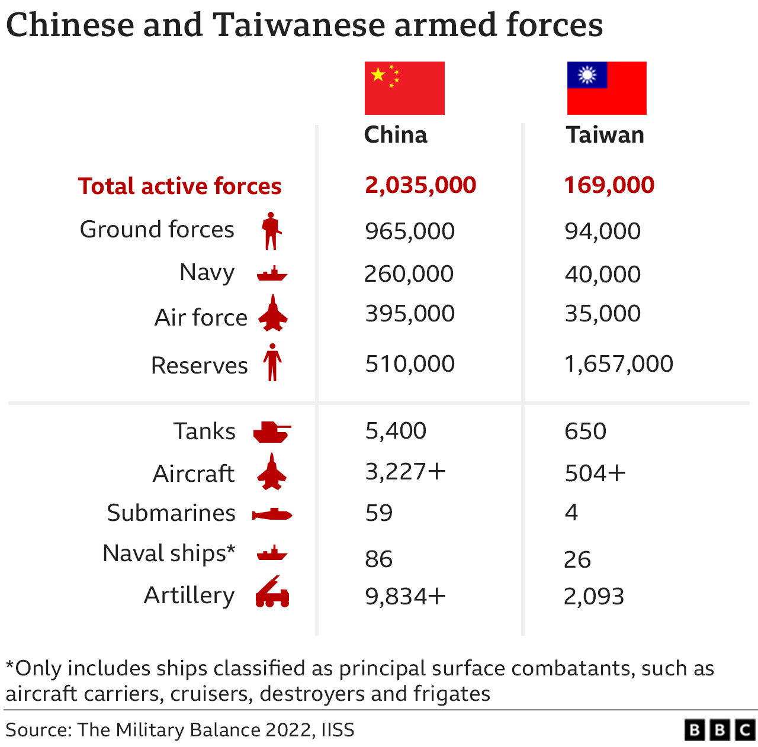
Can Taiwan defend itself?

Slide 27
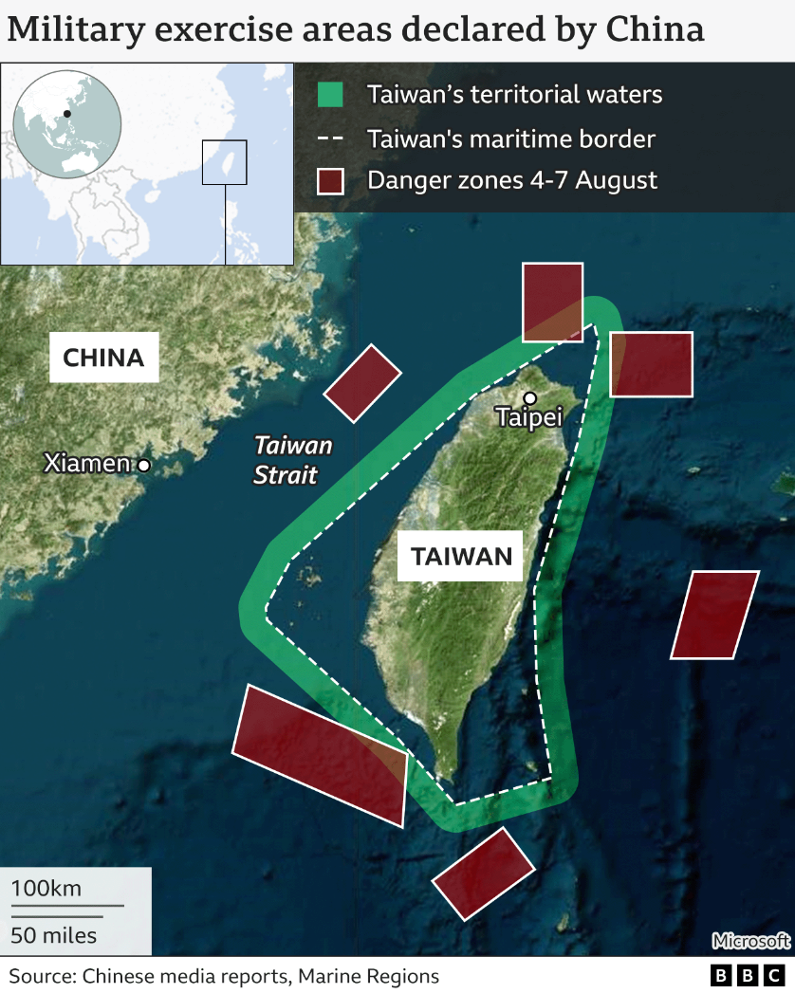

Slide 28
